Slide 1
Chapter 3
Arithmetic for Computers
Notes:
Morgan Kaufmann Publishers
Chapter 3 — Arithmetic for Computers

Slide 2
Floating Point
§3.5 Floating Point
Representation for non-integral numbers
  Including very small and very large numbers
Like scientific notation
  –2.34 × 10⁵⁶
  +0.002 × 10^{–4}
  +987.02 × 10⁹
In binary
  ±1.xxxxxxx₂ × 2^{yyyy}
Types float and double in C
Chapter 3 — Arithmetic for Computers — <number>
Notes:
Morgan Kaufmann Publishers
Chapter 3 — Arithmetic for Computers

Slide 3
Floating Point Standard
Defined by IEEE Std 754-1985
Developed in response to divergence of representations
  Portability issues for scientific code
Now almost universally adopted
Two representations
  Single precision (32-bit)
  Double precision (64-bit)
Chapter 3 — Arithmetic for Computers — <number>
Notes:
Morgan Kaufmann Publishers
Chapter 3 — Arithmetic for Computers

Slide 4
IEEE Floating-Point Format
single: 8 bits
double: 11 bits
single: 23 bits
double: 52 bits
S
Exponent
Fraction
S: sign bit (0 ⇒ non-negative, 1 ⇒ negative)
Normalize significand: 1.0 ≤ |significand| < 2.0
  Always has a leading pre-binary-point 1 bit, so no need to represent it explicitly (hidden bit)
  Significand is Fraction with the “1.” restored
Exponent: excess representation: actual exponent + Bias
  Ensures exponent is unsigned
  Single: Bias = 127; Double: Bias = 1203
Chapter 3 — Arithmetic for Computers — <number>
Notes:
Morgan Kaufmann Publishers
Chapter 3 — Arithmetic for Computers

Slide 5
Single-Precision Range
Exponents 00000000 and 11111111 reserved
Smallest value
  Exponent: 00000001
  ⇒ actual exponent = 1 – 127 = –126
  Fraction: 000…00 ⇒ significand = 1.0
  ±1.0 × 2^{–126} ≈ ±1.2 × 10^{–38}
Largest value
  exponent: 11111110
  ⇒ actual exponent = 254 – 127 = +127
  Fraction: 111…11 ⇒ significand ≈ 2.0
  ±2.0 × 2⁺¹²⁷ ≈ ±3.4 × 10⁺³⁸
Chapter 3 — Arithmetic for Computers — <number>
Notes:
Morgan Kaufmann Publishers
Chapter 3 — Arithmetic for Computers

Slide 6
Double-Precision Range
Exponents 0000…00 and 1111…11 reserved
Smallest value
  Exponent: 00000000001
  ⇒ actual exponent = 1 – 1023 = –1022
  Fraction: 000…00 ⇒ significand = 1.0
  ±1.0 × 2^{–1022} ≈ ±2.2 × 10^{–308}
Largest value
  Exponent: 11111111110
  ⇒ actual exponent = 2046 – 1023 = +1023
  Fraction: 111…11 ⇒ significand ≈ 2.0
  ±2.0 × 2⁺¹⁰²³ ≈ ±1.8 × 10⁺³⁰⁸
Chapter 3 — Arithmetic for Computers — <number>
Notes:
Morgan Kaufmann Publishers
Chapter 3 — Arithmetic for Computers

Slide 7
Floating-Point Example
Represent –0.75
  –0.75 = (–1)¹ × 1.1₂ × 2^{–1}
  S = 1
  Fraction = 1000…00₂
  Exponent = –1 + Bias
    Single: –1 + 127 = 126 = 01111110₂
    Double: –1 + 1023 = 1022 = 01111111110₂
Single: 1011111101000…00
Double: 1011111111101000…00
Chapter 3 — Arithmetic for Computers — <number>
Notes:
Morgan Kaufmann Publishers
Chapter 3 — Arithmetic for Computers

Slide 8
Floating-Point Example
What number is represented by the single-precision float
11000000101000…00
  S = 1
  Fraction = 01000…00₂
  Exponent = 10000001₂ = 129
x = (–1)¹ × (1 + 01₂) × 2^{(129 – 127)}
  = (–1) × 1.25 × 2²
  = –5.0
Chapter 3 — Arithmetic for Computers — <number>
Notes:
Morgan Kaufmann Publishers
Chapter 3 — Arithmetic for Computers

Slide 9
Floating-Point Addition
Consider a 4-digit decimal example
  9.999 × 10¹ + 1.610 × 10^{–1}
1. Align decimal points
  Shift number with smaller exponent
  9.999 × 10¹ + 0.016 × 10¹
2. Add significands
  9.999 × 10¹ + 0.016 × 10¹ = 10.015 × 10¹
3. Normalize result & check for over/underflow
  1.0015 × 10²
4. Round and renormalize if necessary
  1.002 × 10²
Chapter 3 — Arithmetic for Computers — <number>
Notes:
Morgan Kaufmann Publishers
Chapter 3 — Arithmetic for Computers

Slide 10
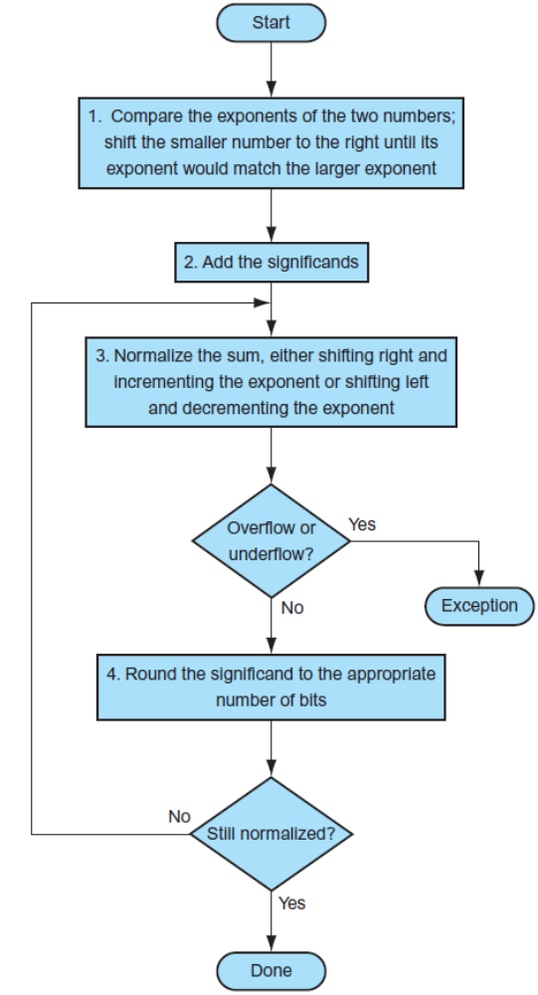
Floating-Point Addition
Consider a 4-digit binary example
  1.000₂ × 2^{–1} + –1.110₂ × 2^{–2} (0.5 + –0.4375)
1. Align binary points
  Shift number with smaller exponent
  1.000₂ × 2^{–1} + –0.111₂ × 2^{–1}
2. Add significands
  1.000₂ × 2^{–1} + –0.111₂ × 2–1 = 0.001₂ × 2^{–1}
3. Normalize result & check for over/underflow
  1.000₂ × 2^{–4}, with no over/underflow
4. Round and renormalize if necessary
  1.000₂ × 2^{–4} (no change) = 0.0625
Chapter 3 — Arithmetic for Computers — <number>
Notes:
Morgan Kaufmann Publishers
Chapter 3 — Arithmetic for Computers

Slide 11
FP Adder Hardware
Much more complex than integer adder
Doing it in one clock cycle would take too long
  Much longer than integer operations
  Slower clock would penalize all instructions
FP adder usually takes several cycles
  Can be pipelined
Chapter 3 — Arithmetic for Computers — <number>
Notes:
Morgan Kaufmann Publishers
Chapter 3 — Arithmetic for Computers

Slide 12

FP Adder Hardware
-2
1.110
-1
1.000
-2
-1
-1
1.110
1.000
Step 1
0
1
0
1.110
-2
0.111
1.000
Step 2
0.001
0
0
-2
0.001
Step 3
1.000
Step 4
-4
Chapter 3 — Arithmetic for Computers — <number>
0
1.000
-4
Notes:
Morgan Kaufmann Publishers
Chapter 3 — Arithmetic for Computers

Slide 13
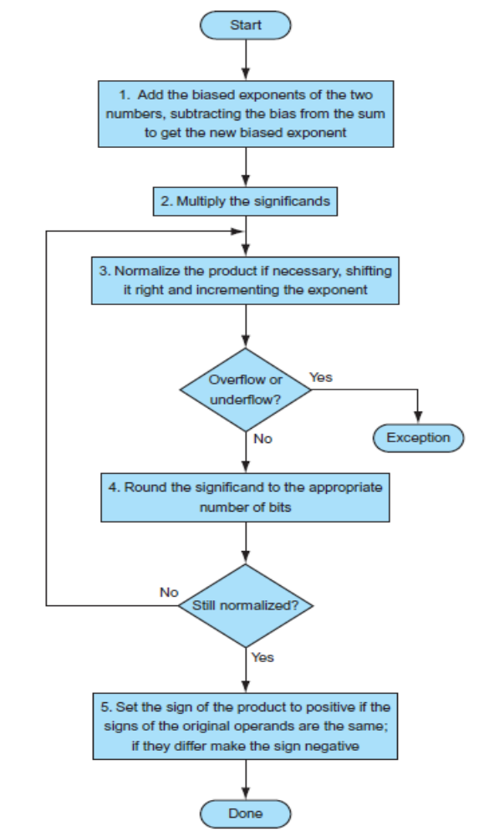
Floating-Point Multiplication
Now consider a 4-digit binary example
  1.000₂ × 2^{–1} × –1.110₂ × 2^{–2} (0.5 × –0.4375)
1. Add exponents
  Unbiased: –1 + –2 = –3
  Biased: (–1 + 127) + (–2 + 127) – 127= –3 + 254 – 127 = –3 + 127
2. Multiply significands
  1.000₂ × 1.110₂ = 1.1102 ⇒ 1.110₂ × 2^{–3}
3. Normalize result & check for over/underflow
  1.110₂ × 2^{–3} (no change) with no over/underflow
4. Round and renormalize if necessary
  1.110₂ × 2^{–3} (no change)
5. Determine sign: +ve × –ve ⇒ –ve
  –1.110₂ × 2^{–3} = –0.21875
Chapter 3 — Arithmetic for Computers — <number>
Notes:
Morgan Kaufmann Publishers
Chapter 3 — Arithmetic for Computers

Slide 14
FP Arithmetic Hardware
FP multiplier is of similar complexity to FP adder
  But uses a multiplier for significands instead of an adder
FP arithmetic hardware usually does
  Addition, subtraction, multiplication, division, reciprocal, square-root
  FP ↔ integer conversion
Operations usually takes several cycles
  Can be pipelined
Chapter 3 — Arithmetic for Computers — <number>
Notes:
Morgan Kaufmann Publishers
Chapter 3 — Arithmetic for Computers

